Slide 1

MyWelly
.Project Title:
MyWelly : Health Consultation Web platform
.Prepared by:
Safar Fatima Ezzahra
Elansari Zineb
Bellaou Salma

Slide 2
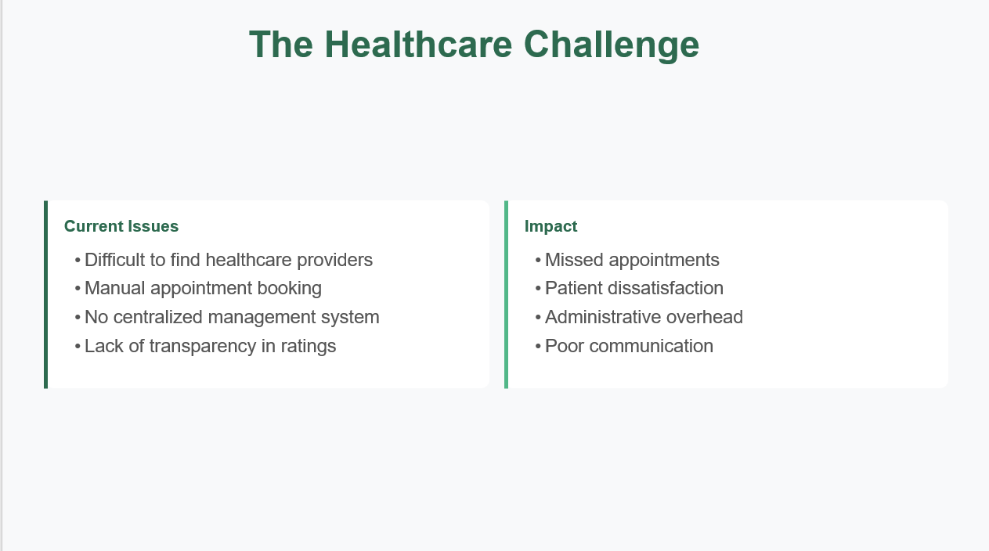
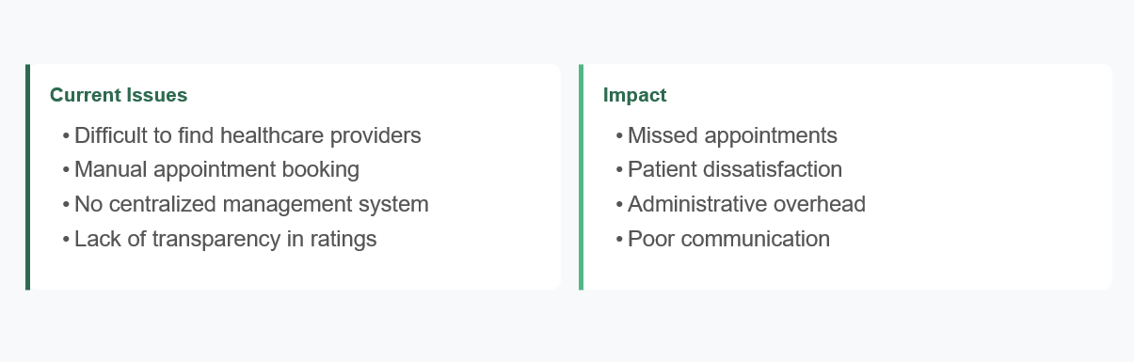
The Healthcare Challenge

Slide 3
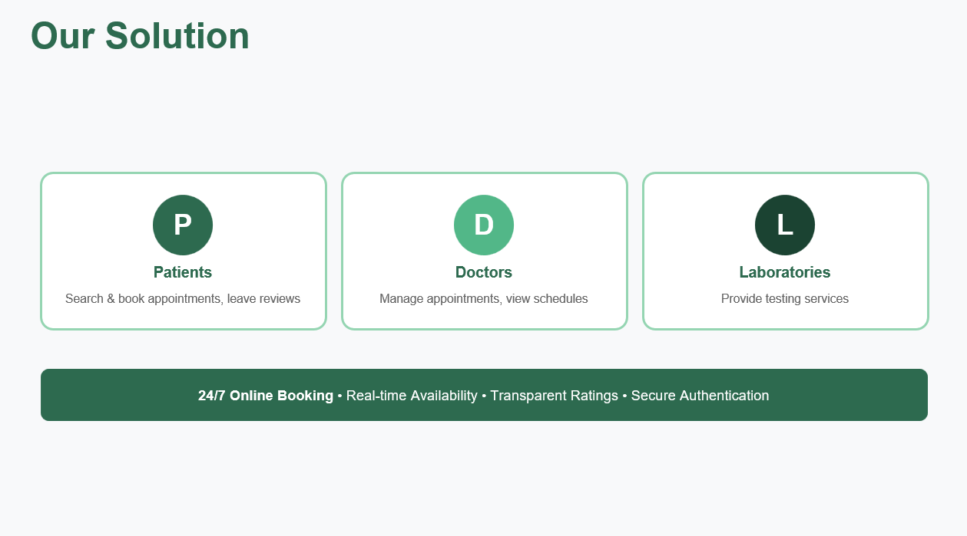

Slide 4
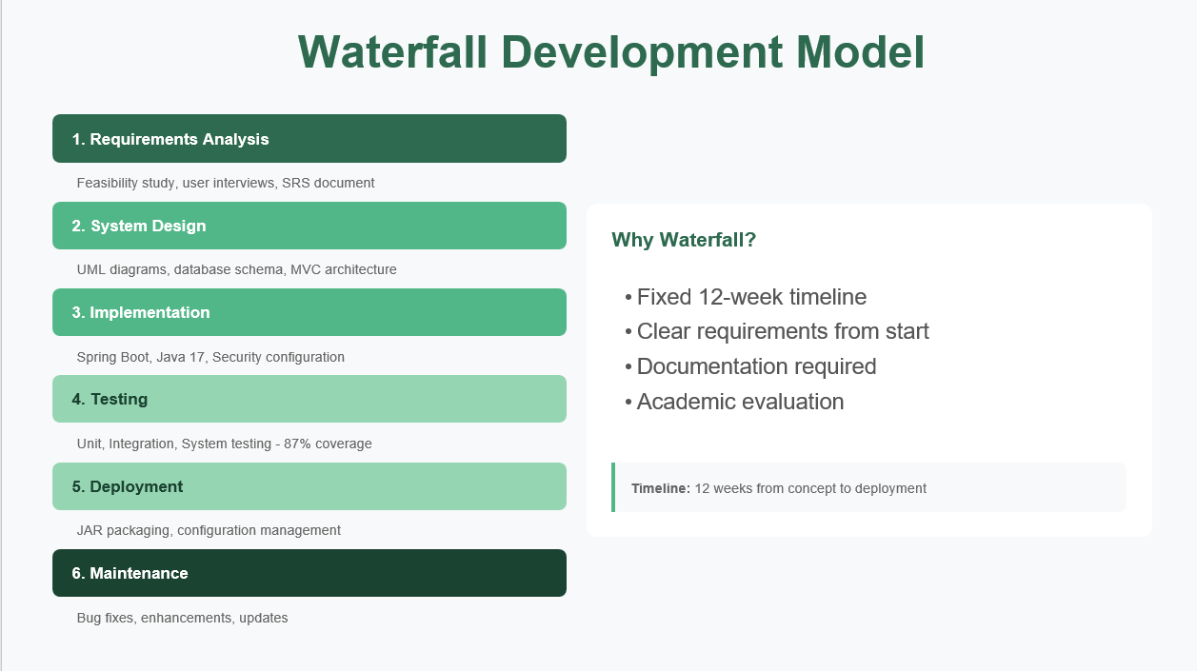

Slide 5
Feasibility Study Report

Slide 6
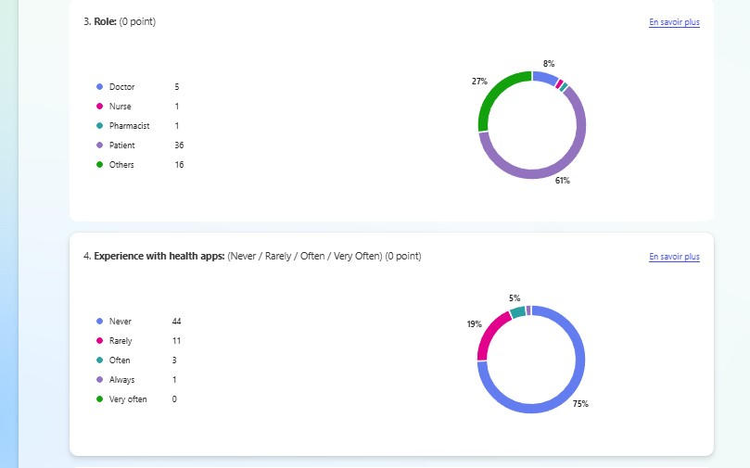
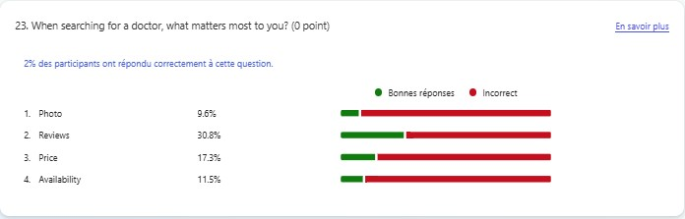
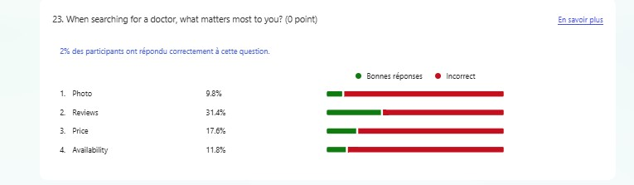

Slide 7
SRS Report

Slide 8
SRS Report
Users and Benefits:
Patients: 24/7 booking, access to records, verified reviews.
Doctors: Manage schedules.
Main functinalities :
Sign-up/Login
Search
Appointment Management
ReviewsStatus Tracking

Slide 9
Non-Functional requirements :
99% availability
Secure data encryption
Daily automatic backups
Goal:
Enhance Morocco’s healthcare experience by improving efficiency, security, and accessibility.

Slide 10
Design

Slide 11
UML diagrams

Slide 12
MVC Architecture
Controller
REST endpoints
Request handling
Model
View
Entities: User, Patient
Doctor, Appointment
Thymeleaf templates
HTML + CSS
Service Layer
Repository
Database
Data access
H2 (in-memory)
Business logic
Notes:
7

Slide 13
SOLID principles

Slide 14
Database Design
User (Base)
id, email, password, role, createdAt
Doctor
Laboratory
Patient
firstName, lastName
specialty, rating
labName, location
services, phone
firstName, lastName
dateOfBirth, phone
Appointment
patient (FK), doctor (FK), date, time, status
Review
patient (FK), doctor/lab (FK), rating (1-5), comment
Notes:
8

Slide 15
Security Design
🔐 Password Security
🛡️ Protection
Salt automatically generated
One way hashing
Secure password storage
SQL injection protection (JPA)
Input validation
Secure HTTP headers
🔑 Access Control
✓ Compliance
Role based authorization (RBAC)
Patient/Doctor/Lab permissions
Session management
Privacy policy implemented
Data minimization
User consent tracking
Notes:
9

Slide 16
Implementation

Slide 17
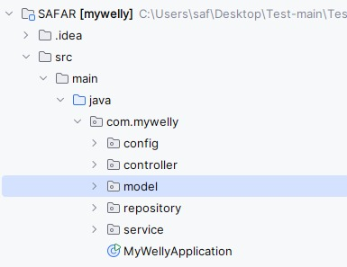
Project Structure

Slide 18
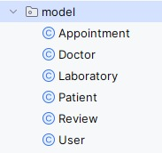
Model
Model package contains the main database entities.
Laboratory → represents labs and their services.
Appointment → links patients with doctors, includes date and time.
User → handles authentication and roles.
All classes use JPA annotations like @Entity and @Id.

Slide 19
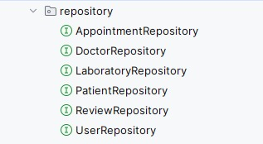
repository
The repository layer extends JpaRepository, which gives us methods like save(), findAll(), findById(), and delete() without writing SQL.

Slide 20
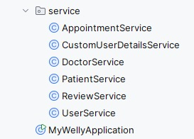
service
The service layer contains the business logic of the application.
AppointmentService → schedules appointments and checks availability.
CustomUserDetailsService → supports Spring Security login.
This separation ensures controllers stay clean, while all logic happens in the service layer.

Slide 21
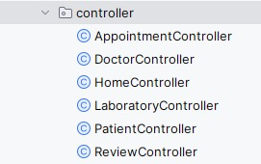
controller
The controller layer handles all HTTP requests __GET, POST, PUT, DELETE — and calls the service layer to execute logic

Slide 22

configuration
The configuration layer includes:
SecurityConfig.java → sets up Spring Security, defines login procedures, and manages role-based access
DataInitializer.java → inserts demo data automatically when the application starts

Slide 23
Testing

Slide 24
Demo

Slide 25
Thank You

